Slide 1
Out of Contest
Powered by unstop

Slide 2
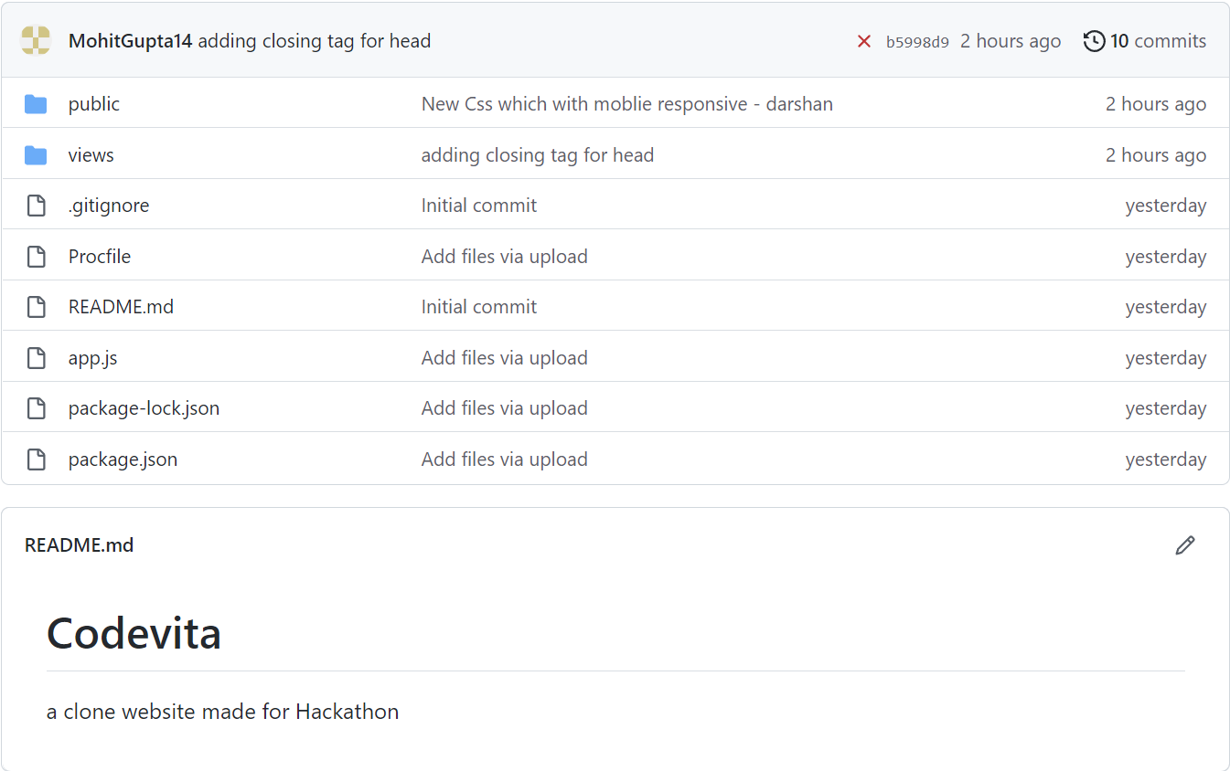
GitHub repository
https://github.com/MohitGupta14/Codevita/

Slide 3
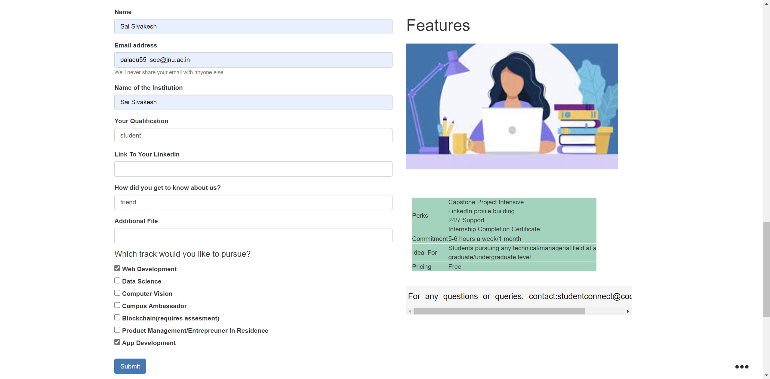
Website hosted on HEROKU
https://codevita1.herokuapp.com/

Slide 4
Contributions
Darshan: Making it mobile responsive and styling.
Mohit Gupta: backend node.js, database and website layout
Sai sivakesh: navigation bar, styling and pop up button.

